Slide 1
Risk Management: Identifying and Assessing Risk
Chapter 4

Slide 2
Learning Objectives:
Upon completion of this chapter you should be able to:
  Define risk management and its role in the SecSDLC
  Understand how risk is identified
  Assess risk based on the likelihood of occurrence and impact on an organization
  Grasp the fundamental aspects of documenting risk identification and assessment
Principles of Information Security - Chapter 4
Slide <number>
Notes:
Learning Objectives:
Upon completion of this chapter you should be able to:
Define risk management and its role in the SecSDLC
Understand how risk is identified
Assess risk based on the likelihood of occurrence and impact on an organization
Grasp the fundamental aspects of documenting risk identification and assessment

Slide 3
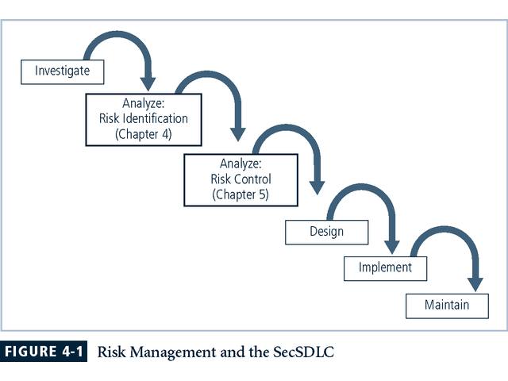
Principles of Information Security - Chapter 4
Slide <number>
Notes:
Introduction
The Security Systems Development Life Cycle (or SecSDLC) is a process framework or methodology that can be used in a flexible fashion to assist organizations in deploying information security initiatives.
Risk identification is the formal process of examining and documenting the current information technology security situation.
Risk identification is conducted within the larger process of identifying and justifying risk controls, known as risk management.

Slide 4
Risk Management
“If you know the enemy and know yourself, you need not fear the result of a hundred battles.
If you know yourself but not the enemy, for every victory gained you will also suffer a defeat.
If you know neither the enemy nor yourself, you will succumb in every battle.”
Principles of Information Security - Chapter 4
Slide <number>
Notes:
RISK MANAGEMENT
“If you know the enemy and know yourself, you need not fear the result of a hundred battles.
If you know yourself but not the enemy, for every victory gained you will also suffer a defeat.
If you know neither the enemy nor yourself, you will succumb in every battle.” (Sun Tzu)

Slide 5
Know Ourselves
First, we must identify, examine, and understand the information, and systems, currently in place
In order to protect our assets, defined here as the information and the systems that use, store, and transmit it, we have to understand everything about the information
Once we have examined these aspects, we can then look at what we are already doing to protect the information and systems from the threats
Principles of Information Security - Chapter 4
Slide <number>
Notes:
KNOW OURSELVES
First, we must identify, examine, and understand the information, and systems, currently in place.
In order to protect our assets, defined here as the information and the systems that use, store, and transmit it, we have to understand everything about the information.
Once we have examined these aspects, we can then look at what we are already doing to protect the information and systems from the threats.

Slide 6
Know the Enemy
For information security this means identifying, examining, and understanding the threats that most directly affect our organization and the security of our organization’s information assets
We then can use our understanding of these aspects to create a list of threats prioritized by importance to the organization
Principles of Information Security - Chapter 4
Slide <number>
Notes:
KNOW THE ENEMY
Informed of our own nature, and aware of our own weaknesses, we must then know the enemy.
For information security this means identifying, examining, and understanding the threats that most directly affect our organization and the security of our organization’s information assets.
We then can use our understanding of these aspects to create a list of threats prioritized by importance to the organization.

Slide 7
Accountability for Risk Management
It is the responsibility of each community of interest to manage risks; each community has a role to play:
  Information Security - best understands the threats and attacks that introduce risk into the organization
  Management and Users – play a part in the early detection and response process - they also insure sufficient resources are allocated
  Information Technology – must assist in building secure systems and operating them safely
Principles of Information Security - Chapter 4
Slide <number>
Notes:
Accountability for Risk Management
It is the responsibility of each of the organization’s communities of interest to manage the risks the organization encounters. Each community of interest has a role to play.
Information Security - best understand the threats and attacks that introduce risk into the organization.
Management and Users – play a part in the early detection and response process. They also insure sufficient resources) are allocated
Information Technology – must assist in building secure systems and operating them safely.
General management, IT management, and information security management are accountable for identifying and classifying risk.
All three communities of interest are also responsible for:
Evaluating the risk controls
Determining which control options are cost effective for the organization
Acquiring or installing the needed controls
Overseeing that the controls remain effective in controlling risk

Slide 8
Accountability for Risk Management
All three communities must also:
  Evaluate the risk controls
  Determine which control options are cost effective
  Assist in acquiring or installing needed controls
  Ensure that the controls remain effective
Principles of Information Security - Chapter 4
Slide <number>
Notes:
Accountability for Risk Management
It is the responsibility of each of the organization’s communities of interest to manage the risks the organization encounters. Each community of interest has a role to play.
Information Security - best understand the threats and attacks that introduce risk into the organization.
Management and Users – play a part in the early detection and response process. They also insure sufficient resources) are allocated
Information Technology – must assist in building secure systems and operating them safely.
General management, IT management, and information security management are accountable for identifying and classifying risk.
All three communities of interest are also responsible for:
Evaluating the risk controls
Determining which control options are cost effective for the organization
Acquiring or installing the needed controls
Overseeing that the controls remain effective in controlling risk

Slide 9
Risk Management Process
Management reviews for asset inventory
The threats and vulnerabilities that have been identified as dangerous to the asset inventory must be reviewed and verified as complete and current
The potential controls and mitigation strategies should be reviewed for completeness
The cost effectiveness of each control should be reviewed as well, and the decisions about deployment of controls revisited
Further, managers of all levels are accountable on a regular schedule for ensuring the ongoing effectiveness of every control deployed
Principles of Information Security - Chapter 4
Slide <number>
Notes:
Risk management process
1) The first focus of management review is asset inventory.
2) Next the threats and vulnerabilities that have been identified as dangerous to the asset inventory must be reviewed and verified as complete and current, and the potential controls and mitigation strategies should be reviewed for completeness.
3) The cost effectiveness of each control should be reviewed as well, and the decisions about deployment of controls revisited.
4) Further, managers of all levels are accountable on a regular schedule for insuring the ongoing effectiveness of every control deployed.

Slide 10
Risk Identification
A risk management strategy calls on us to “know ourselves” by identifying, classifying, and prioritizing the organization’s information assets
These assets are the targets of various threats and threat agents and our goal is to protect them from these threats
Next comes threat identification:
  Assess the circumstances and setting of each information asset
  Identify the vulnerabilities and begin exploring the controls that might be used to manage the risks
Principles of Information Security - Chapter 4
Slide <number>
Notes:
Risk Identification
A risk management strategy calls on us to “know ourselves” by identifying, classifying, and prioritizing the organization’s information assets.
These assets are the targets of various threats and threat agents and our goal is to protect them from these threats.
Once we have gone through the process of self-examination, we then move into threat identification.
We must assess the circumstances and setting of each information asset.
To begin managing the risk from the vulnerabilities, we must identify those vulnerabilities and begin exploring the controls that might be used to manage the risks.
We begin the process by identifying and assessing the value of our information assets.

Slide 11
Asset Identification and Valuation
This iterative process begins with the identification of assets, including all of the elements of an organization’s system: people, procedures, data and information, software, hardware, and networking elements
Then, we classify and categorize the assets adding details as we dig deeper into the analysis
Principles of Information Security - Chapter 4
Slide <number>
Notes:
Asset Identification and Valuation
This iterative process begins with the identification of assets, including all of the elements of an organization’s system: people, procedures, data and information, software, hardware and networking elements.
Then, we classify and categorize the assets adding details as we dig deeper into the analysis.

Slide 12
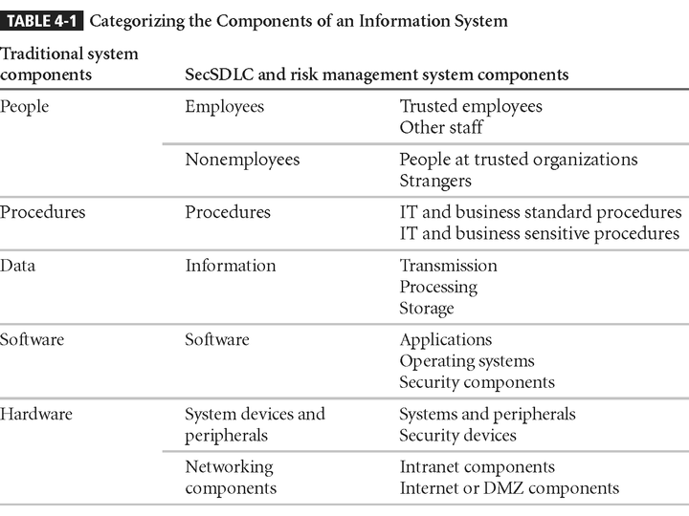
DMZ-1
DMZ-2
Principles of Information Security - Chapter 4
Slide <number>

Slide 13
People, Procedures, and Data Asset Identification
Unlike the tangible hardware and software elements, the human resources, documentation, and data information assets are not as readily discovered and documented
These assets should be identified, described, and evaluated by people using knowledge, experience, and judgment
As these elements are identified, they should also be recorded into some reliable data handling process
Principles of Information Security - Chapter 4
Slide <number>
Notes:
People, Procedures, and Data Asset Identification
Unlike the tangible hardware and software elements already described, the human resources, documentation, and data information assets are not as readily discovered and documented.
These assets should be identified, described, and evaluated by people using knowledge, experience, and judgment.
As these elements are identified, they should also be recorded into some reliable data handling process.

Slide 14
Asset Information for People
For People:
  Position name/number/ID – try to avoid names and stick to identifying positions, roles, or functions
  Supervisor
  Security clearance level
  Special skills
Principles of Information Security - Chapter 4
Slide <number>
Notes:
People, Procedures, and Data Asset Identification
For People:
Position name/number/ID – try to stay aware from names and stick to identifying positions, roles or functions
Supervisor
Security clearance level
Special skills

Slide 15
Asset Information for Procedures
For Procedures:
  Description
  Intended purpose
  What elements is it tied to
  Where is it stored for reference
  Where is it stored for update purposes
Principles of Information Security - Chapter 4
Slide <number>
Notes:
People, Procedures, and Data Asset Identification
For Procedures:
Description
Intended purpose
What elements is it tied to
Where is it stored for reference
Where is it stored for update purposes

Slide 16
Asset Information for Data
For Data:
  Classification
  Owner/creator/manager
  Size of data structure
  Data structure used – sequential, relational
  Online or offline
  Where located
  Backup procedures employed
Principles of Information Security - Chapter 4
Slide <number>
Notes:
People, Procedures, and Data Asset Identification
For Data:
Classification
Owner/creator/manager
Size of data structure
Data structure used – sequential, relational
Online or offline
Where located
Backup procedures employed

Slide 17
Hardware, Software, and Network Asset Identification
What attributes of each of these information assets should be tracked?
When deciding which information assets to track, consider including these asset attributes:
  Name
  IP address
  MAC address
  Element type
  Serial number
  Manufacturer name
  Manufacturer’s model number or part number
  Software version, update revision, or FCO number
  Physical location
  Logical location
  Controlling entity
Principles of Information Security - Chapter 4
Slide <number>
Notes:
Hardware, Software, and Network Asset Identification
What attributes of each of these information assets should be tracked?
When deciding which information assets to track, consider including these asset attributes:
Name
IP address
MAC address
Element Type
DeviceClass = S (server)
DeviceOS = W2K (windows 2000)
DeviceCapacity = AS (Advanced Server)
Hardware, Software, and Network Asset Identification
Serial number
Manufacturer Name
Manufacturer’s Model Number or Part Number
Software Version, Update Revision, or FCO number
Physical Location
Logical location
Controlling Entity

Slide 18
Hardware, Software, and Network Asset Identification
Automated tools can sometimes uncover the system elements that make up the hardware, software, and network components
Once created, the inventory listing must be kept current, often through a tool that periodically refreshes the data
Principles of Information Security - Chapter 4
Slide <number>
Notes:
Hardware, Software, and Network Asset Identification
Automated tools can sometimes uncover the system elements that make up the hardware, software, and network components.
Once created and stored, the inventory listing must be kept current, often through a tool that periodically refreshes the data.

Slide 19
Information Asset Classification
Many organizations already have a classification scheme
Examples of these kinds of classifications are:
  confidential data
  internal data
  public data
Informal organizations may have to organize themselves to create a useable data classification model
The other side of the data classification scheme is the personnel security clearance structure
Principles of Information Security - Chapter 4
Slide <number>
Notes:
Information Asset Classification
Many organizations already have a classification scheme.
Examples of these kinds of classifications are confidential data, internal data, and public data. Informal organizations may have to organize themselves to create a useable data classification model.
The other side of the data classification scheme is the personnel security clearance structure, identifying the level of information each individual is authorized to view, based on his need-to-know.

Slide 20
Information Asset Valuation
Each asset is categorized
Questions to assist in developing the criteria to be used for asset valuation:
  Which information asset is the most critical to the success of the organization?
  Which information asset generates the most revenue?
  Which information asset generates the most profitability?
  Which information asset would be the most expensive to replace?
  Which information asset would be the most expensive to protect?
  Which information asset would be the most embarrassing or cause the greatest liability if revealed?
Principles of Information Security - Chapter 4
Slide <number>
Notes:
Information Asset Valuation
As each asset of the organization is assigned to its category, these questions will assist in developing the criteria to be used for asset valuation :
Which information asset is the most critical to the success of the organization?
Which information asset generates the most revenue?
Which information asset generates the most profitability?
Which information asset would be the most expensive to replace?
Which information asset would be the most expensive to protect?
Which information asset would be the most embarrassing or cause the greatest liability if revealed?

Slide 21
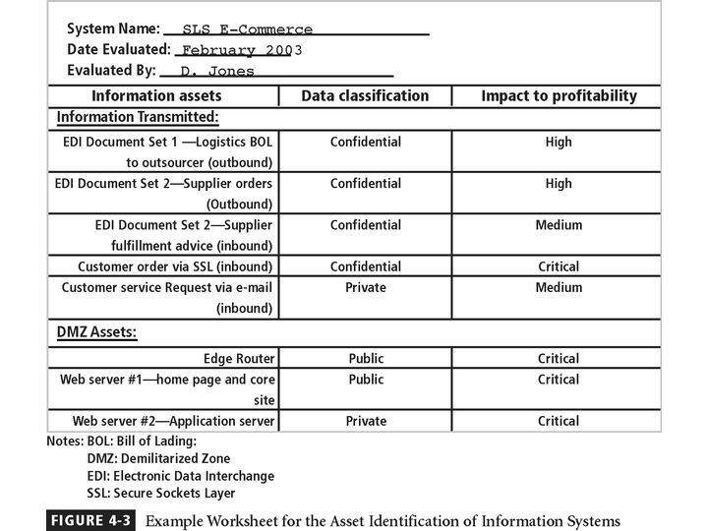
Figure 4-3 – Example Worksheet
Principles of Information Security - Chapter 4
Slide <number>

Slide 22
Information Asset Valuation
Create a weighting for each category based on the answers to the previous questions
  Which factor is the most important to the organization?
Once each question has been weighted, calculating the importance of each asset is straightforward
List the assets in order of importance using a weighted factor analysis worksheet
Principles of Information Security - Chapter 4
Slide <number>
Notes:
Information Asset Valuation
In order to finalize this step of the information asset identification process, each organization should create a weighting for each category based on the answers to the previous questions.
Which Factor is the most important to the organization?
Once each question has been weighted, calculating the importance of each asset is straightforward. The final step is to list the assets in order of importance. This can be achieved by using a weighted factor analysis worksheet.

Slide 23
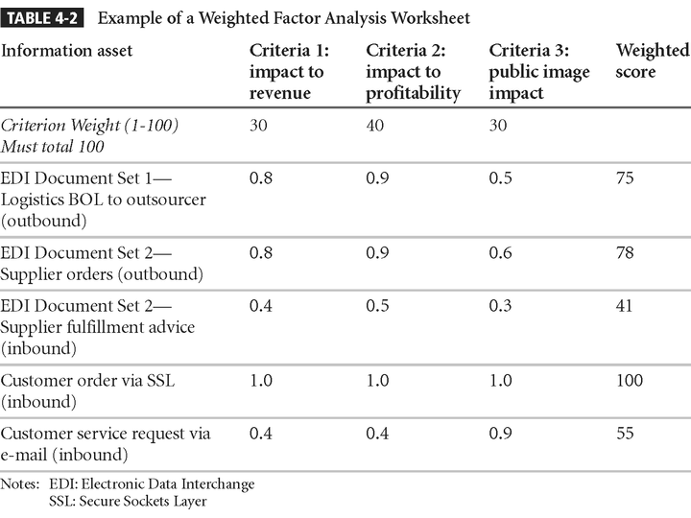
Principles of Information Security - Chapter 4
Slide <number>

Slide 24
Data Classification and Management
A variety of classification schemes are used by corporate and military organizations
Information owners are responsible for classifying the information assets for which they are responsible
Information owners must review information classifications periodically
The military uses a five-level classification scheme but most organizations do not need the detailed level of classification used by the military or federal agencies
Principles of Information Security - Chapter 4
Slide <number>
Notes:
Data Classification and Management
A variety of classification schemes are used by corporate and military organizations.
Information owners are responsible for classifying the information assets for which they are responsible.
At least once a year, information owners must review information classifications to ensure the information is still classified correctly and the appropriate access controls are in place.
The U.S. Military Classification Scheme has a more complex categorization system than required by most corporations. For most information, the military uses a five-level classification scheme: Unclassified, Sensitive But Unclassified (i.e., For Official Use Only), Confidential, Secret, and Top Secret.
Most organizations do not need the detailed level of classification used by the military or federal agencies. A simple scheme will allow the organization to protect its sensitive information like: Public, For official use only, Sensitive, Classified

Slide 25
Security Clearances
The other side of the data classification scheme is the personnel security clearance structure
Each user of data in the organization is assigned a single level of authorization indicating the level of classification
Before an individual is allowed access to a specific set of data, he or she must meet the need-to-know requirement
This extra level of protection ensures that the confidentiality of information is properly maintained
Principles of Information Security - Chapter 4
Slide <number>
Notes:
Security Clearances
The other side of the data classification scheme is the personnel security clearance structure. For each user of data in the organization, a single level of authorization must be assigned, indicating the level of classification he is authorized to view.
Before an individual is allowed access to a specific set of data, he must meet the need-to-know requirement.
This extra level of protection ensures that the confidentiality of information is properly maintained.

Slide 26
Management of Classified Data
Includes the storage, distribution, portability, and destruction of classified information
  Must be clearly marked as such
  When stored, it must be unavailable to unauthorized individuals
  When carried should be inconspicuous, as in a locked briefcase or portfolio
Clean desk policies require all information to be stored in its appropriate storage container at the end of each day
Proper care should be taken to destroy any unneeded copies
Dumpster diving can prove embarrassing to the organization
Principles of Information Security - Chapter 4
Slide <number>
Notes:
Management of Classified Data
Requirements for the management of information include the storage, distribution, portability, and destruction of classified information.
Information that has a classification designation other than unclassified or public must be clearly marked as such.
When classified data is stored, it must be unavailable to unauthorized individuals.
When an individual carries classified information, it should be inconspicuous, as in a locked briefcase or portfolio.
The clean desk policy, which requires each employee to secure any and all information in its appropriate storage container at the end of each day.
When classified information is no longer valuable or excessive copies exist, proper care should be taken to destroy any unneeded copies, through shredding, burning or transfer to an authorized document destruction service.
There are those individuals who would not hesitate to engage in dumpster diving to retrieve information that could prove embarrassing or compromise the security of information in the organization.

Slide 27
Threat Identification
Each of the threats identified so far has the potential to attack any of the assets protected
This will quickly become more complex and overwhelm the ability to plan
To make this part of the process manageable, each step in the threat identification and vulnerability identification process is managed separately, and then coordinated at the end of the process
Principles of Information Security - Chapter 4
Slide <number>
Notes:
Threat Identification
Each of these threats identified has the potential to attack any of the assets protected.
If we assume every threat can and will attack every information asset, this will quickly become more complex and overwhelm the ability to plan.
To make this part of the process manageable, each step in the threat identification and vulnerability identification process is managed separately, and then coordinated at the end of the process.

Slide 28
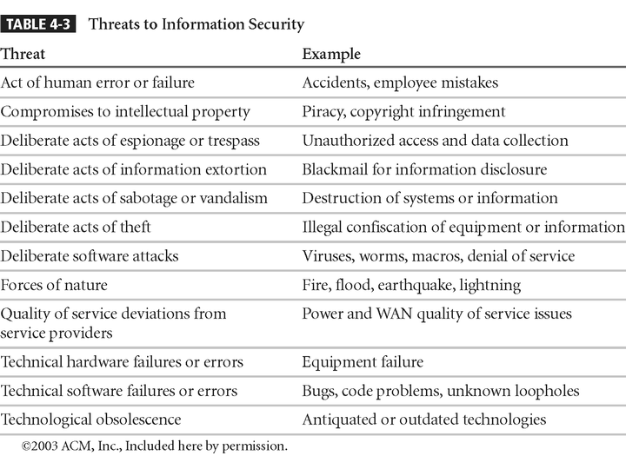
Principles of Information Security - Chapter 4
Slide <number>

Slide 29
Identify and Prioritize Threats
Each threat must be further examined to assess its potential to impact organization - this is referred to as a threat assessment
To frame the discussion of threat assessment, address each threat with a few questions:
  Which threats present a danger to this organization’s assets in the given environment?
  Which threats represent the most danger to the organization’s information?
  How much would it cost to recover from a successful attack?
  Which of these threats would require the greatest expenditure to prevent?
Principles of Information Security - Chapter 4
Slide <number>
Notes:
Identify And Prioritize Threats and Threat Agents
Before threats can be used in the process, each threat must be further examined to assess its potential to impact the specific targeted organization. This is referred to as a threat assessment.
To frame the discussion of threat assessment, address each threat with a few questions:
Which threats present a danger to this organization’s assets in the given environment?
Which threats represent the most danger to the organization’s information?
How much would it cost to recover from a successful attack?
Which of these threats would require the greatest expenditure to prevent?

Slide 30
Vulnerability Identification
We now face the challenge of reviewing each information asset for each threat it faces and creating a list of the vulnerabilities that remain viable risks to the organization
Vulnerabilities are specific avenues that threat agents can exploit to attack an information asset
Principles of Information Security - Chapter 4
Slide <number>
Notes:
Vulnerability Identification
We now face the challenge of reviewing each information asset for each threat it faces and creating a list of the vulnerabilities that remain viable risks to the organizations.
Vulnerabilities are specific avenues that threat agents can exploit to attack an information asset.

Slide 31
Vulnerability Identification
Examine how each of the threats that are possible or likely could be perpetrated and list the organization’s assets and their vulnerabilities
The process works best when groups of people with diverse backgrounds within the organization work iteratively in a series of brainstorming sessions
At the end of the process, an information asset / vulnerability list has been developed
  this list is the starting point for the next step, risk assessment
Principles of Information Security - Chapter 4
Slide <number>
Notes:
Vulnerability Identification
Now, we examine how each of the threats that are possible or likely, could be perpetrated and list the organization’s assets and their vulnerabilities.
The process works best when groups of people with diverse backgrounds within the organization work iteratively in a series of brainstorming sessions.
At the end of the process, an information asset / vulnerability list has been developed. This list is the starting point for the next step, risk assessment.

Slide 32
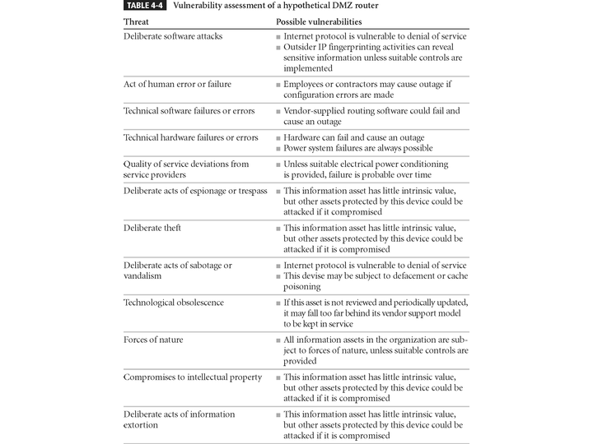
Table 4-4 – Vulnerability Assessment Example
router
router
Principles of Information Security - Chapter 4
Slide <number>

Slide 33
Risk Assessment
We can determine the relative risk for each of the vulnerabilities through a process called risk assessment
Risk assessment assigns a risk rating or score to each specific information asset, useful in gauging the relative risk introduced by each vulnerable information asset and making comparative ratings later in the risk control process
Principles of Information Security - Chapter 4
Slide <number>
Notes:
Risk Assessment
We can determine the relative risk for each of the vulnerabilities through a process called risk assessment.
Risk assessment assigns a risk rating or score to each specific information asset, useful in gauging the relative risk introduced by each vulnerable information asset and making comparative ratings later in the risk control process.

Slide 34
Introduction to Risk Assessment
Risk Identification Estimate Factors
  Likelihood
  Value of Information Assets
  Percent of Risk Mitigated
  Uncertainty
Principles of Information Security - Chapter 4
Slide <number>
Notes:
Introduction to Risk Assessment
Risk Identification Estimate Factors
Likelihood
Value of Information Assets
Percent of Risk Mitigated
Uncertainty
Factors in Risk Estimation
Likelihood is the overall rating of the probability of occurrence that a potential vulnerability may be exercised within the organization’s threat environment. (i.e. between 0.1 for low and 1.0 for high)
Valuation of Information Assets. We can assign weighted scores for the value of each information asset to the organization. (i.e. a scale of 1 to 100, with 100 reserved for the utmost mission critical assets)
Percentage of Risk Mitigated by Current Controls. If a vulnerability is fully managed by an existing control, it no longer needs to be considered for additional controls and can be set aside. If it is partially controlled, estimate what percentage of the vulnerability has been controlled.
Uncertainty. It is not possible to know everything about each vulnerability and how likely it is to occur and how much impact it will have. We must apply judgment to add a factor into the equation to allow for an estimation of the uncertainty of the information

Slide 35
Risk Determination
For the purpose of relative risk assessment:
risk =
(value (or impact) of information asset ×
likelihood of vulnerability occurrence)
× (100% −
percentage of risk already controlled +
an element of uncertainty)
Principles of Information Security - Chapter 4
Slide <number>
Notes:
Risk Determination
For the purpose of relative risk assessment:
risk =
likelihood of vulnerability occurrence times
value (or impact)
minus
percentage risk already controlled
plus
an element of uncertainty

Slide 36
Identify Possible Controls
For each threat and its associated vulnerabilities that have any residual risk, create a preliminary list of control ideas
Residual risk is the risk that remains to the information asset even after the existing control has been applied
Principles of Information Security - Chapter 4
Slide <number>
Notes:
Identify Possible Controls
For each threat and its associated vulnerabilities that have any residual risk, create a preliminary list of control ideas.
Residual risk is the risk that remains to the information asset even after the existing control has been applied.

Slide 37
3 General Categories of Control
Policies
Programs
Technologies
Details in page 143 of text…
Principles of Information Security - Chapter 4
Slide <number>

Slide 38
Access Controls
One particular application of controls is in the area of access controls
Access controls are those controls that specifically address admission of a user into a trusted area of the organization
There are a number of approaches to controlling access
Access controls can be
  discretionary
  mandatory
  nondiscretionary
Principles of Information Security - Chapter 4
Slide <number>
Notes:
Access Controls
One particular application of controls is in the area of access controls. Access controls are those controls that specifically address admission of a user into a trusted area of the organization.
There are a number of approaches to controlling access. Access controls can be discretionary, mandatory, or non-discretionary.

Slide 39
Types of Access Controls
Discretionary Access Controls (DAC) are implemented at the discretion or option of the data user
Mandatory Access Controls (MACs) are structured and coordinated with a data classification scheme, and are required
Nondiscretionary Controls are those determined by a central authority in the organization and can be based on that individual’s role (Role-Based Controls) or a specified set of duties or tasks the individual is assigned (Task-Based Controls) or can be based on specified lists maintained on subjects or objects
Principles of Information Security - Chapter 4
Slide <number>
Notes:
Types of Access Controls
Discretionary Access Controls (DAC) are implemented at the discretion or option of the data user.
Mandatory Access Controls (MACs) - are structured and coordinated with a data classification scheme, and are required.
Non-discretionary Controls are those determined by a central authority in the organization and can be based on that individual’s role (Role-Based Controls) or a specified set of duties or tasks the individual is assigned (Task-Based Controls) or can be based on specified lists maintained on subjects or objects.

Slide 40
Lattice-based Control
Another type of nondiscretionary access is lattice-based control, where a lattice structure (or matrix) is created containing subjects and objects, and the boundaries associated with each pair is contained
This specifies the level of access each subject has to each object
In a lattice-based control the column of attributes associated with a particular object are referred to as an access control list or ACL
The row of attributes associated with a particular subject (such as a user) is referred to as a capabilities table
Principles of Information Security - Chapter 4
Slide <number>
Notes:
Lattice-based Control
Yet another type of non-discretionary access is lattice-based control, where a lattice structure (or matrix) is created containing subjects and objects, and the boundaries associate with each pair is contained. This specified the level of access each subject has to each object, if any.
In a lattice-based control the column of attributes associated with a particular object (such as a printer) are referred to as an access control list or ACL.
The row of attributes associated with a particular subject (such as a user) is referred to as a capabilities table.

Slide 41
Documenting Results of Risk Assessment
The goal of this process has been to identify the information assets of the organization that have specific vulnerabilities and create a list of them, ranked for focus on those most needing protection first
In preparing this list we have collected and preserved factual information about the assets, the threats they face, and the vulnerabilities they experience
We should also have collected some information about the controls that are already in place
Principles of Information Security - Chapter 4
Slide <number>
Notes:
Documenting Results of Risk Assessment
The goal of this process has been to identify the information assets of the organization that have specific vulnerabilities and create a list of them, ranked for focus on those most needing protection first.
In preparing this list we have collected and preserved a wealth of factual information about the assets, the threats they face, and the vulnerabilities they experience.
We should also have collected some information about the controls that are already in place.

Slide 42
Introduction to Risk Assessment
The process you develop for risk identification should include designating what function the reports will serve, who is responsible for preparing the reports, and who reviews them
We do know that the ranked vulnerability risk worksheet is the initial working document for the next step in the risk management process: assessing and controlling risk
Principles of Information Security - Chapter 4
Slide <number>
Notes:
Introduction to Risk Assessment
The process you develop for risk identification should include designating what function the reports will serve, who is responsible for preparing the reports, and who reviews them.
We do know that the ranked vulnerability risk worksheet is the initial working document for the next step in the risk management process: assessing and controlling risk.

Slide 43
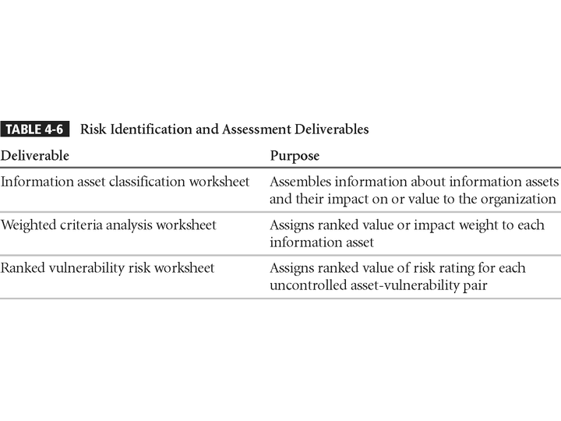
Principles of Information Security - Chapter 4
Slide <number>

